Slide 1
SELF EMBEDDING WATERMARKING SYSTEM
Advisor: Dr. Asif Mahmood Gilani

Slide 2
Outline
Introduction
Literature Review
Previous Work Done
System Overview
Technologies used
Code Explanation
Prototype Results
Future Plan

Slide 3
Introduction
What is Self Embedding Watermarking System?
Areas of usage
Image Watermarking
Video Watermarking
Tamper Detection for image and video
Restoration of tampered image and video

Slide 4
Literature Review
Image Watermarking
Triple Recovery Information Embedding Approach
Pixel-wise Authentication Based Self-Embedding Fragile Watermarking Method
Hash Function Based Fragile Watermarking
Video Watermarking
Video-Tampering Detection and Content Reconstruction via Self-Embedding
Spatiotemporal Trident Networks: Detection and Localization of Object Removal Tampering

Slide 5
Previous Work Done (Mid Evaluation)
Implementation of pixel-wise watermarking and authentication.
Implementation of triple recovery watermarking and authentication.
Comparison of results for both methods.

Slide 6
System Overview
Technologies used
Methodology
Code Explanation

Slide 7
Technologies Used
ReactJS for frontend
Typescript
Styled Components
Material UI
Django for backend
Python for multimedia authentication and recovery modules
Blake2b library

Slide 8
Methodology
Implement two different image watermarking and restoration research papers.
Select the paper with better results and extend for video authentication and recovery.
Watermarking
Hash value generation for authentication bits
Multiple variants of lookup table
Implementation of image division
Tamper detection and restoration
Triple recovery information embedding method
Pixel-wise authentication method
Video watermarking, authentication and restoration

Slide 9
Code Explanation Triple Recovery Method
Lookup table
Image size
Block number
Watermark process
Authentication process
Not handling image size change attacks

Slide 10


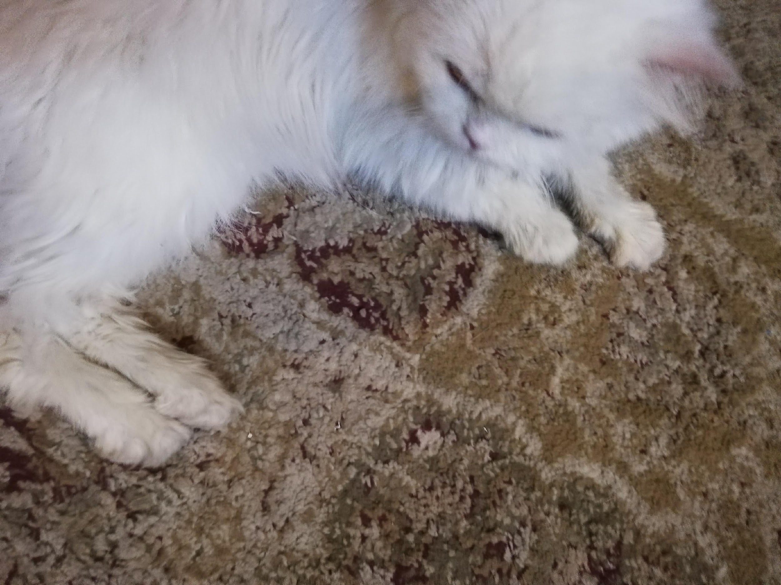
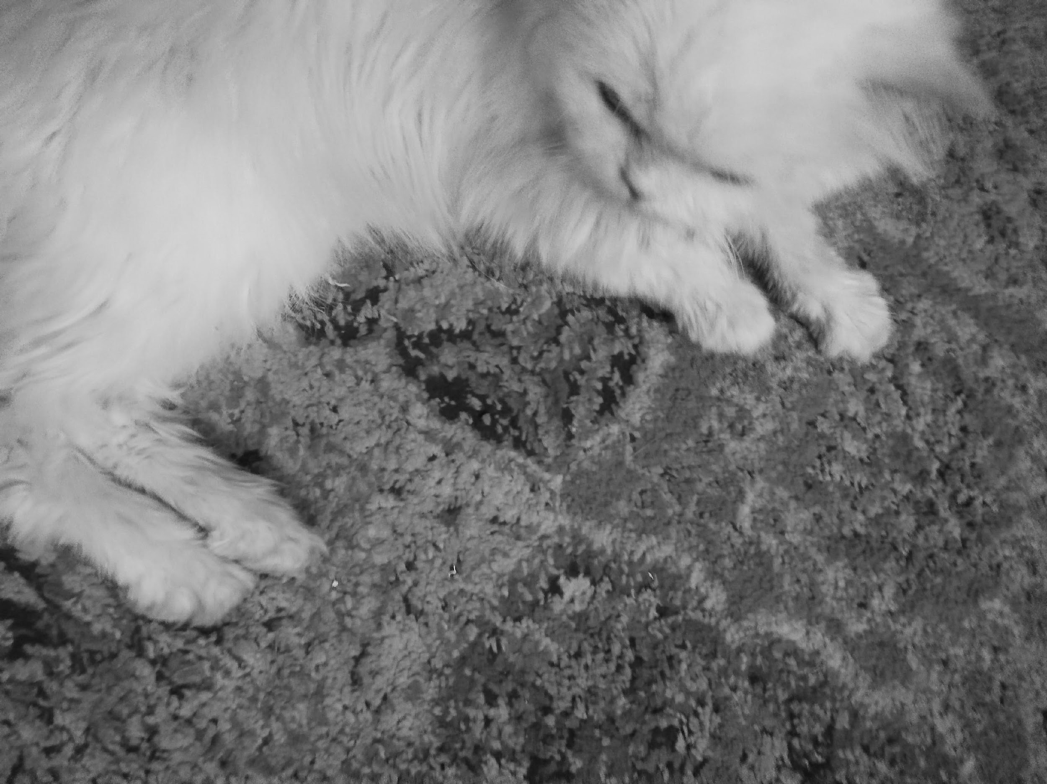
Prototype Results (Triple Recovery Method)
Original Image | Watermarked Image | Execution Time (Seconds) | PSNR (Watermarked Image)
 |  | 10 | 39.97
 |  | 45 | 44.10

Slide 11


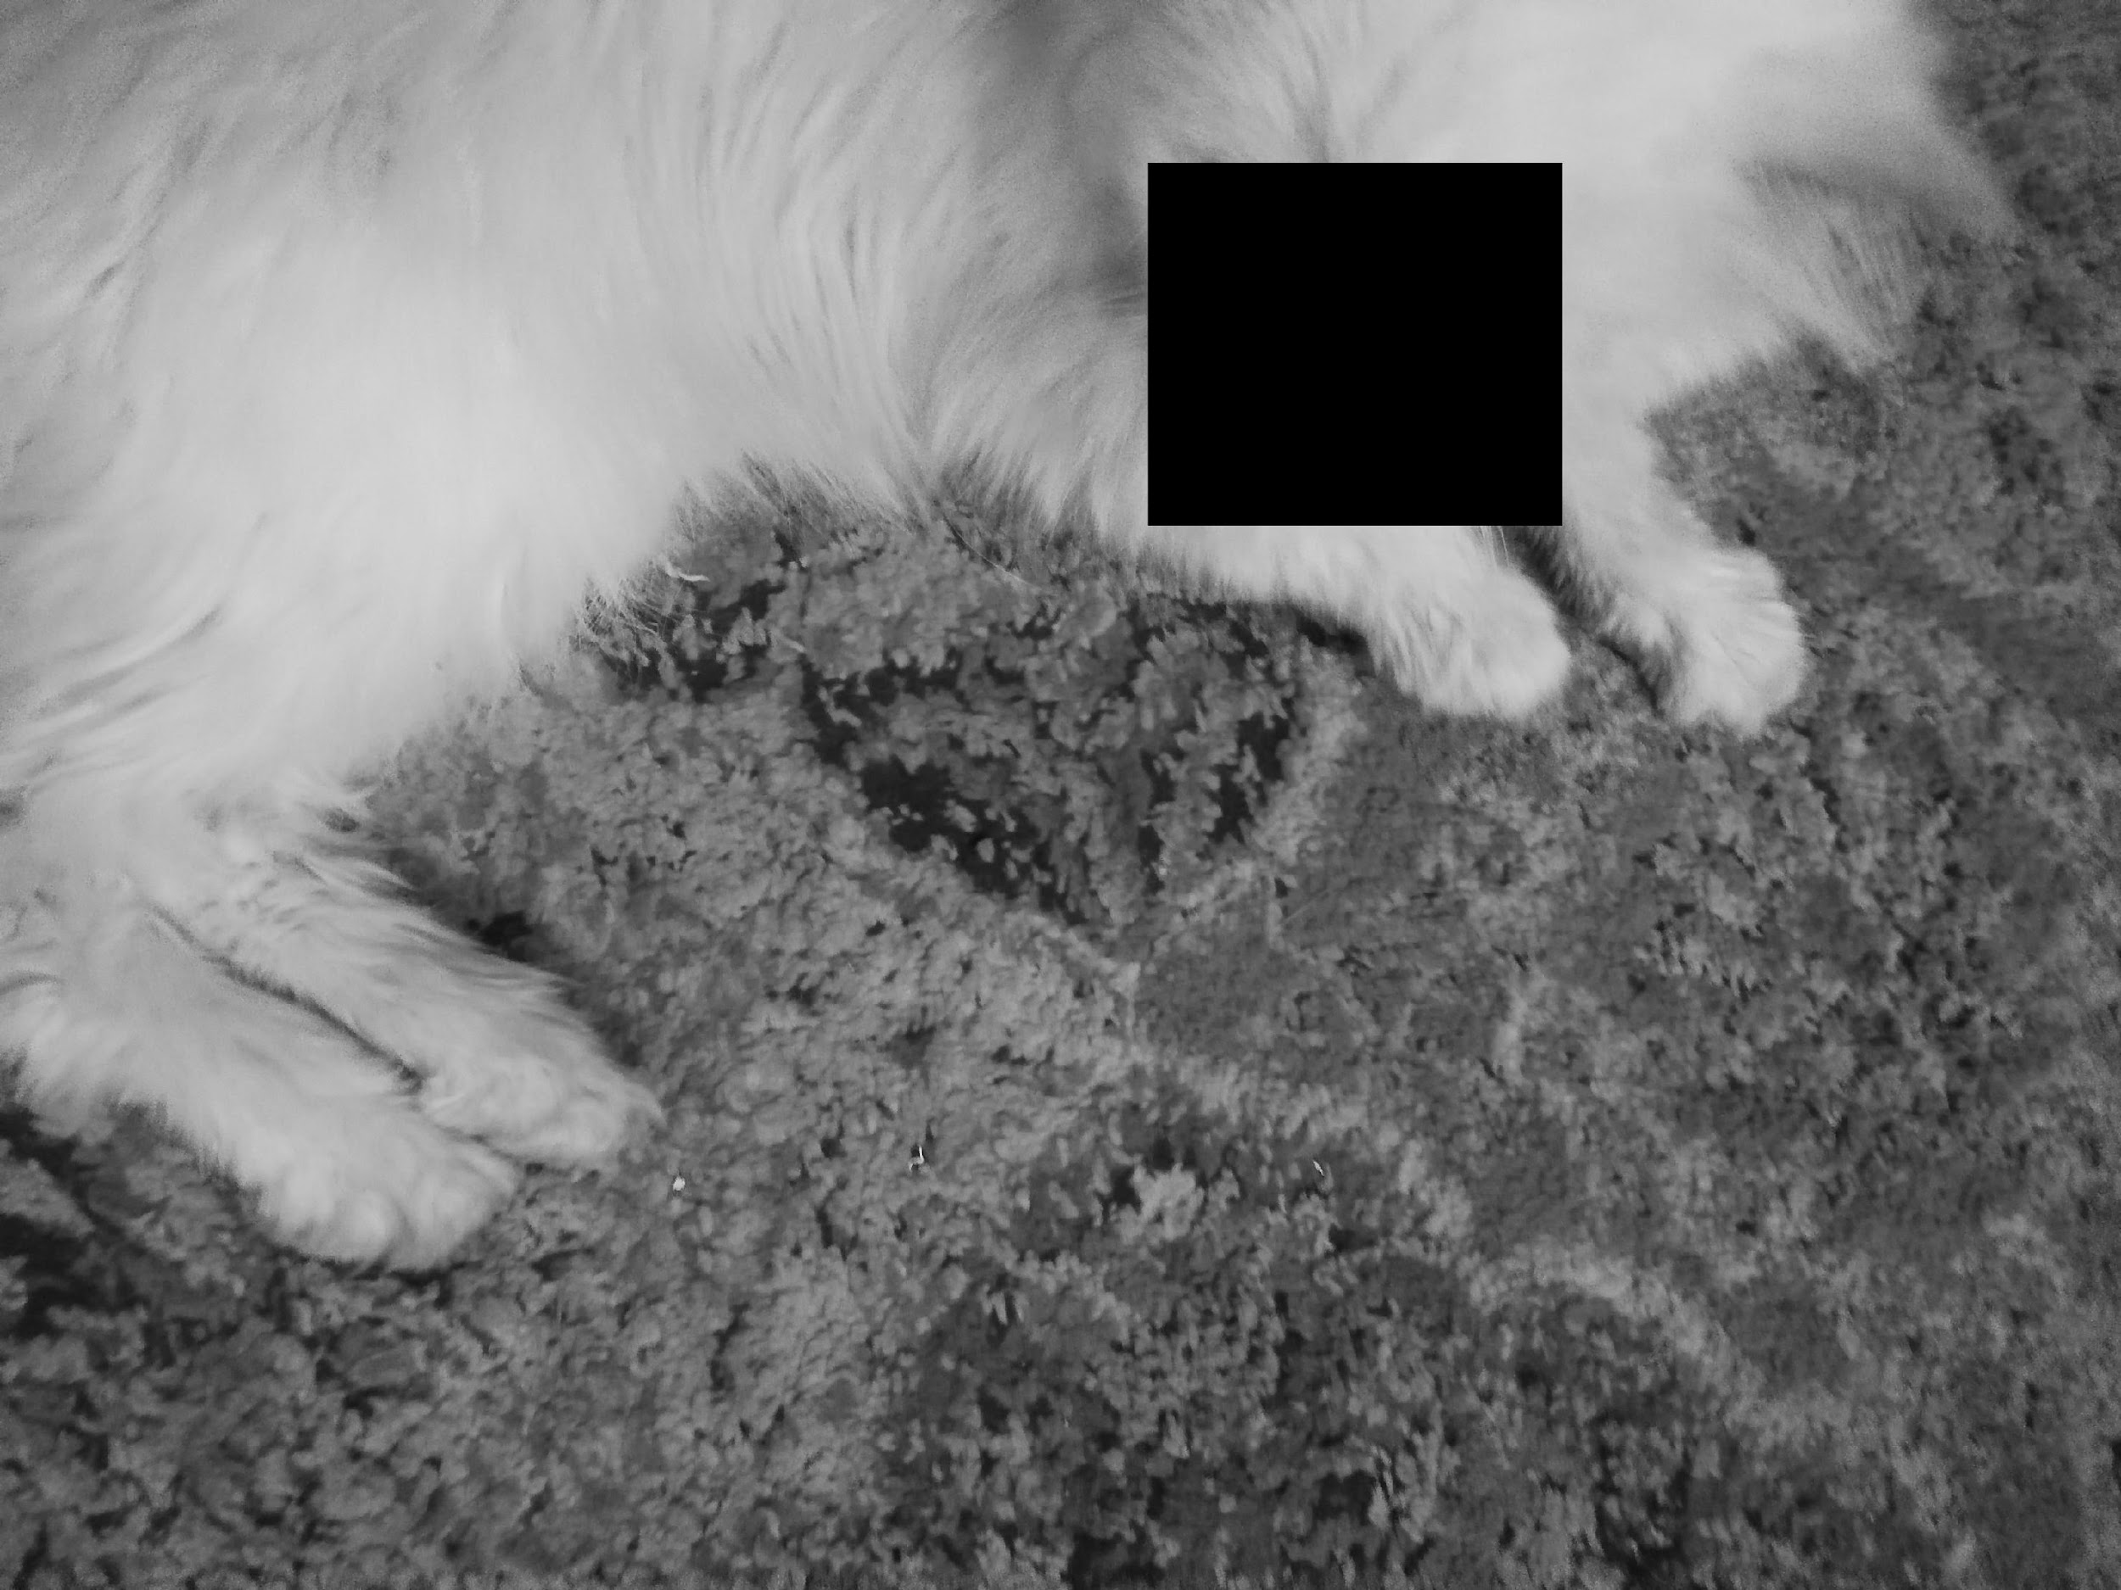

Prototype Results (Triple Recovery Method)
Tampered Image | Output Image

Slide 12

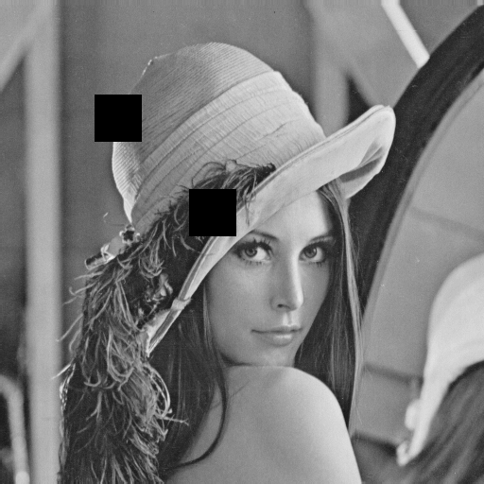

Prototype Results (Triple Recovery Method)
Original Image | Watermarked Image | Tampered Image | Output Image

Slide 13



Prototype Results (Triple Recovery Method)
Original Image | Watermarked Image | Tampered Image | Output Image

Slide 14




Prototype Results (Triple Recovery Method)
Original Image | Watermarked Image | Tampered Image | Output Image

Slide 15

Prototype Results (Triple Recovery Method)
Original Image | Watermarked Image | Tampered Image | Output Image

Slide 16
Improvements
Reduced processing time (numpy strides).
Increased PSNR (interpolation).
Added support for RGB images.
Added support for video watermarking, authentication and restoration.
Added multiple lookup tables (5 new table orientations).

Slide 17
Video Watermarking Process
The triple recovery process is used in the following processes
Video watermarking
Video Authentication
Video Recovery

Slide 18
No key frame
The key frame are discarded because
If key frame itself is lost, then no recovery.
Key frame data is simply copied into the altered frames.
If video is recovered from the key frames, then there are glitches in the resultant video.

Slide 19
Video Watermarking Process
At first the video is divided into array of frames in which each frame goes through the same processes explained above.
As there are many frames, we are using threading for faster results.
After each frame is processed the frame is recombined into a video.

Slide 20
Future Work
Improve quality of recovered region.
Reduce the Video watermarking and recovery time.
Introduce temporal authentication in video.
Implement this logic to pixel level instead of block level.
Browser extension.

Slide 21
References
Gul, E., Ozturk, S. A novel triple recovery information embedding approach for self-embedded digital image watermarking. Multimed Tools Appl 79, 31239–31264 (2020). https://doi.org/10.1007/s11042-020-09548-4
Gul, E., Ozturk, S. A novel pixel-wise authentication-based self-embedding fragile watermarking method. Multimedia Systems 27, 531–545 (2021). https://doi.org/10.1007/s00530-021-00751-3
Gul, E., Ozturk, S. A novel hash function based fragile watermarking method for image integrity. Multimed Tools Appl 78, 17701–17718 (2019). https://doi.org/10.1007/s11042-018-7084-0
P. Deshmane, "MRKFE: Designing cascaded map reduce algorithm for key frame extraction," 2017 International Conference on Information Communication and Embedded Systems (ICICES), 2017, pp. 1-6, doi: 10.1109/ICICES.2017.8070719

Slide 22
THANK YOU
18L-0756 Arbab Hamd Rizwan
18L-0972 Usama Aslam
18L-1131 Aashar Naseem
18L-1139 Hunzlah Malik

